Slide 1


Social Buzz – Client Presentation

Slide 2


Today's agenda
Project recap
Problem
The Analytics team
Process
Insights
Summary

Slide 3


u
Social Buzz, a rapidly growing technology unicorn, is working to adapt to its increasing global scale. Accenture has launched a three-month Proof of Concept (POC) with the following key objectives:
Audit: Evaluate Social Buzz's big data practices.
IPO Recommendations: Provide guidance for a successful Initial Public Offering.
Content Analysis: Identify the top five most popular content categories on the platform.
Project Recap

Slide 4


Problem
Over 100000 posts a day!
And 36,500,00 posts a year!
But how to capitalize on it when there is so much?
We identify the top 5 most popular categories of content

Slide 5



Andrew Fleming
Chief Technical Architect
The Analytics team
Marcus Rompton
Senior Principle
Kamya Bhardwaj
Data Analyst

Slide 6

Process
1
Data Understanding
2
Data Cleaning
3
Data Modelling
4
Data Analysis
5
Uncovering Insights

Slide 7
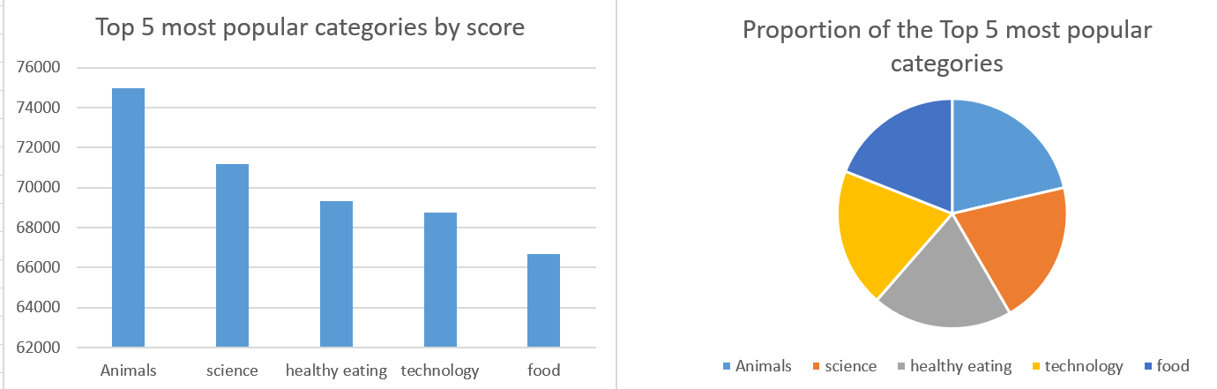


Insights

Slide 8
Process
Process
Additional Insights
There is a total of 16 unique content categories.
Out of which Animal is the most popular having 1897 reactions in total.
May was the most having the most number of posts, around 2138.

Slide 9
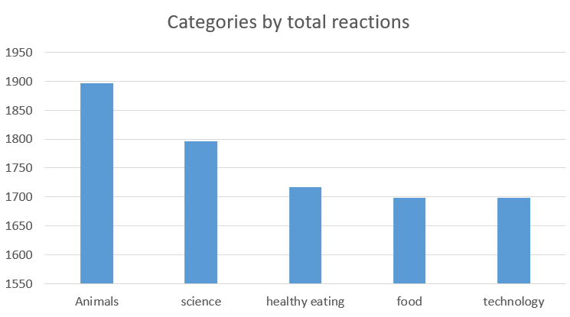

Slide 10
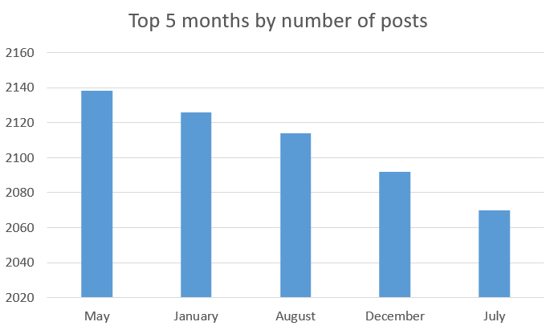

Slide 11
Key Insights:
Most Popular Categories:
Animals and Science are the top-performing categories, indicating that users are most engaged with real-life and factual content.
Food-Related Themes:
Healthy Eating ranks the highest among food-related categories, suggesting a strong interest in this area within the user base.
Summary
Recommendations:
Campaign Opportunities:
Leverage the popularity of the Healthy Eating category by collaborating with brands focused on healthy living and nutrition.
Create targeted campaigns to boost user engagement using these insights.
Next Steps:
While this ad hoc analysis has provided valuable insights, scaling this analysis for real-time understanding of your business is the next logical step.
We can assist in implementing a large-scale production system to enable ongoing, data-driven decision-making.

Slide 12

Thank you!
ANY QUESTIONS?

